Slide 1
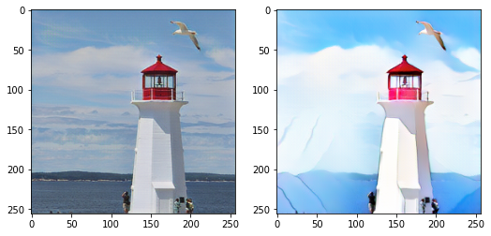
Turning Real Photos into Animations MIE 1517 Group Project
Team 7
Team Members:
Alex Zhan #1004940111
Dongxuan Li #1006421506
Ezio Cui #1006837666
Zihan Gong #1005062101
GitHub - TobiasSunderdiek/cartoon-gan: Implementation of cartoon GAN [Chen et al., CVPR18] with pytorch

Slide 2
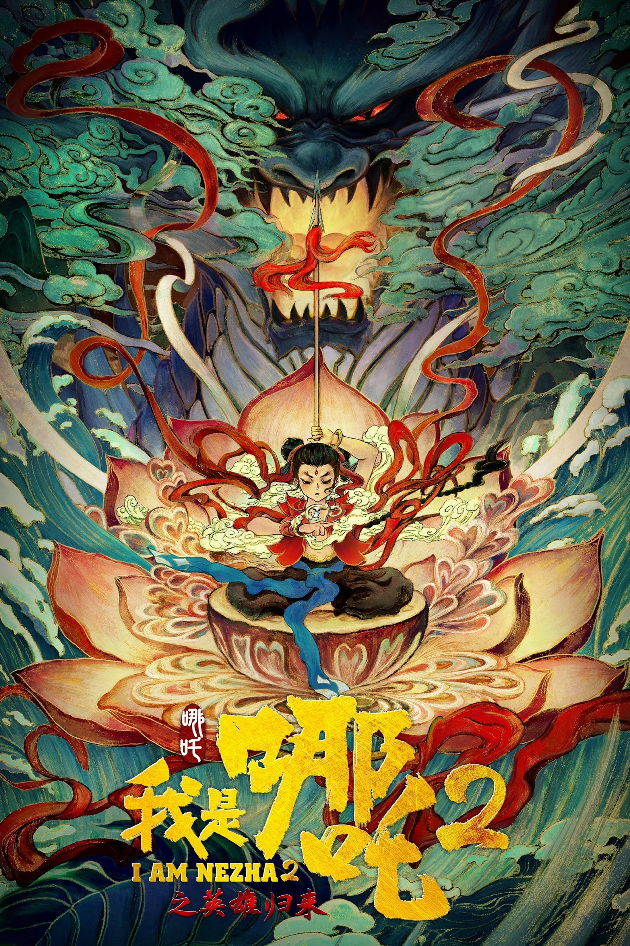
The Problem: From Reality to Cartoon
Real-world → Cartoon-style images using GANs
Animation is a booming trend
Ne Zha 2: $1.7B, highest-grossing animated film
I Am Nezha 2 (2023) - Posters — The Movie Database (TMDB)
Ne Zha 2

Slide 3
AI Meets Creativity
Automate and enhance creative workflows
Empower artists and storytellers
Notes:
We’re inspired by the intersection of technology and creativity. By training AI to create cartoon visuals, we can simplify content creation, support digital artists, and make personalized storytelling more accessible.

Slide 4
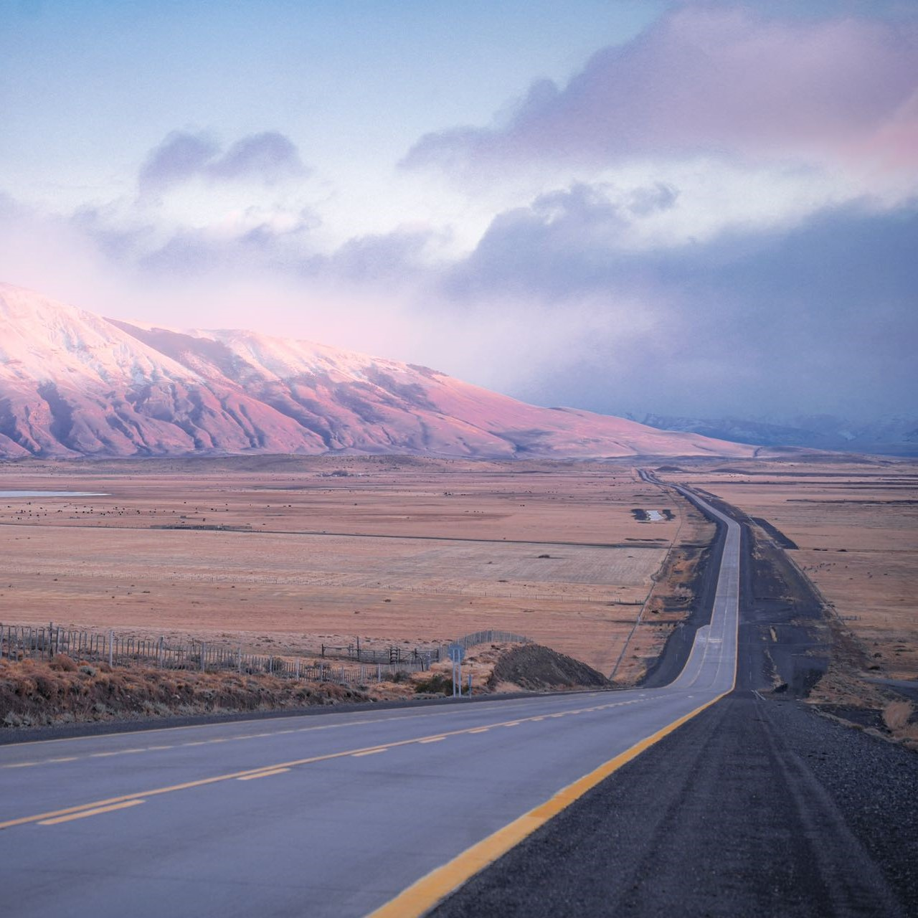
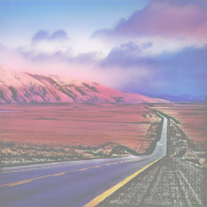
Real Photo to Cartoon
Real
Cartoon

Slide 5
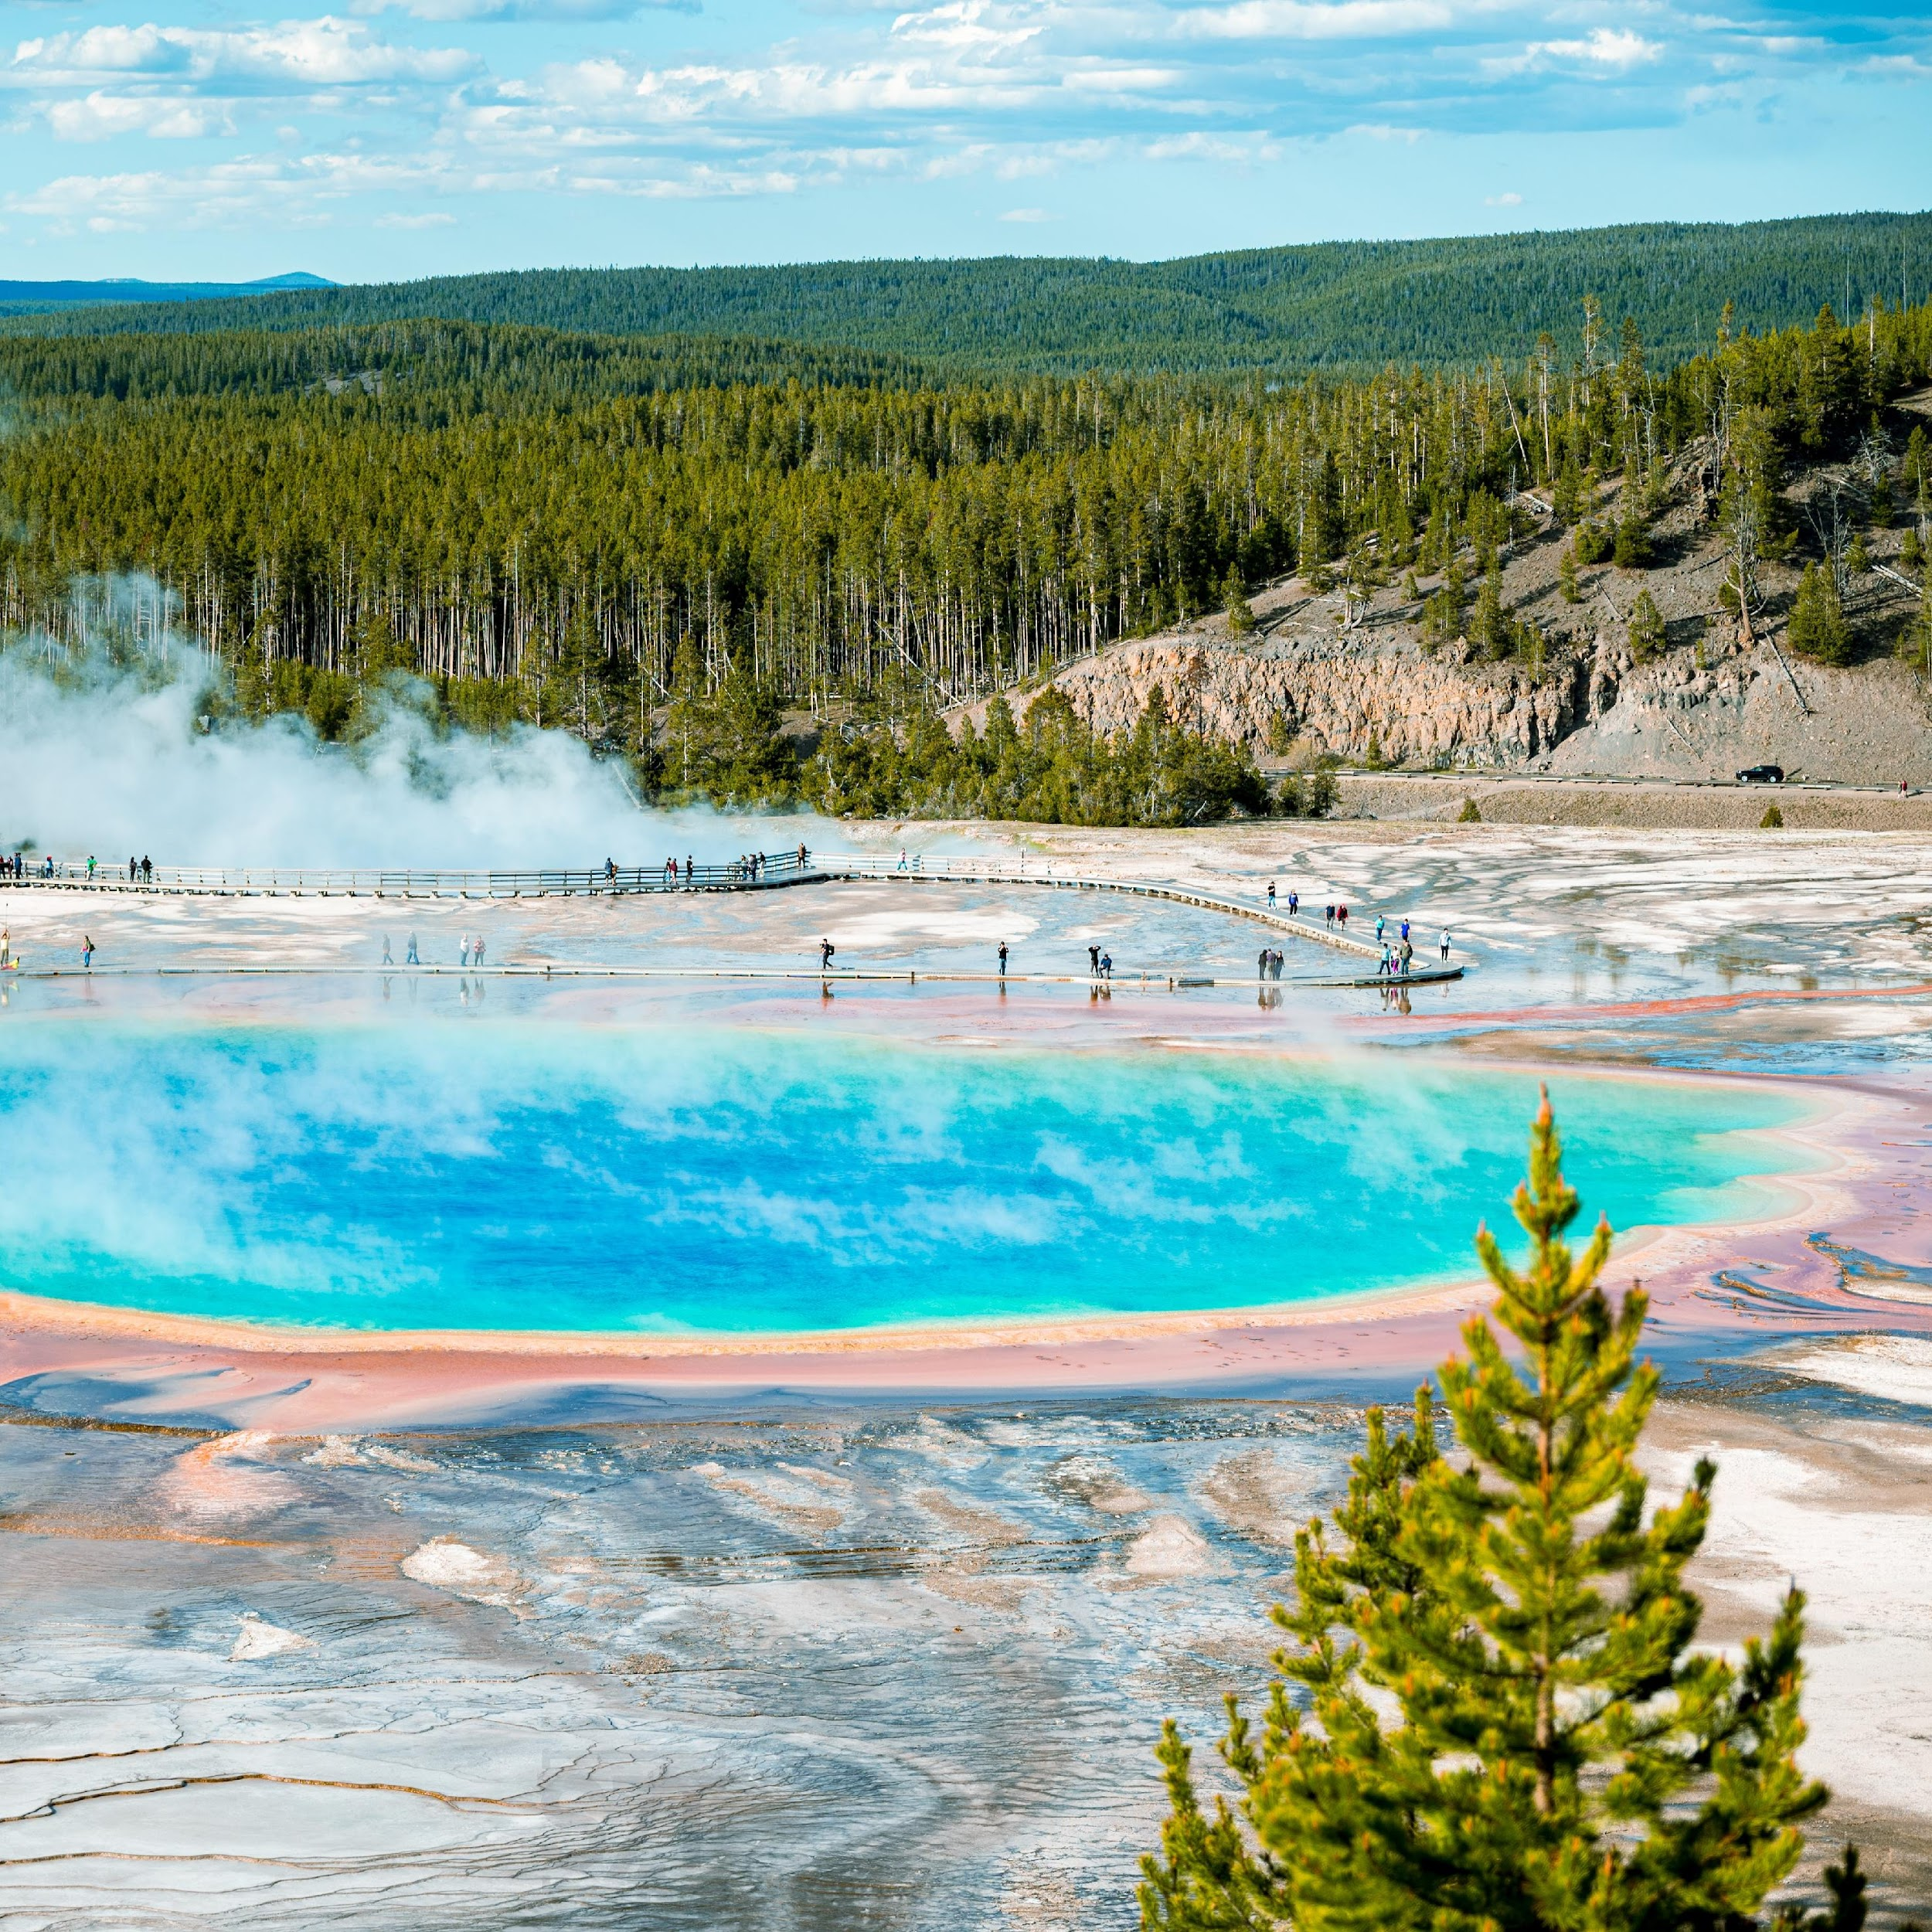
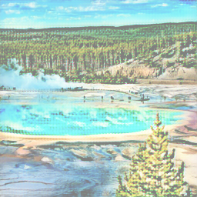
Real Photo to Cartoon
Real
Cartoon

Slide 6
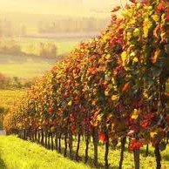
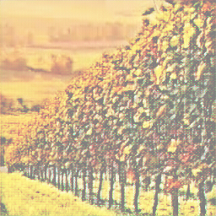
Real Photo to Cartoon
Real
Cartoon

Slide 7
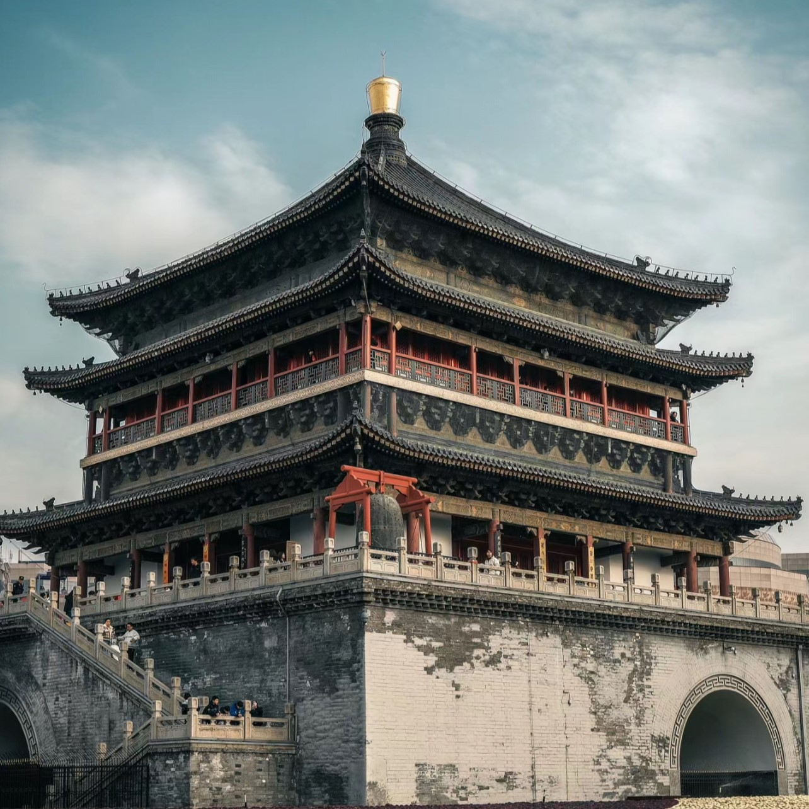
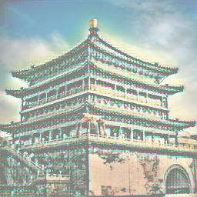
Real Photo to Cartoon
Real
Cartoon

Slide 8
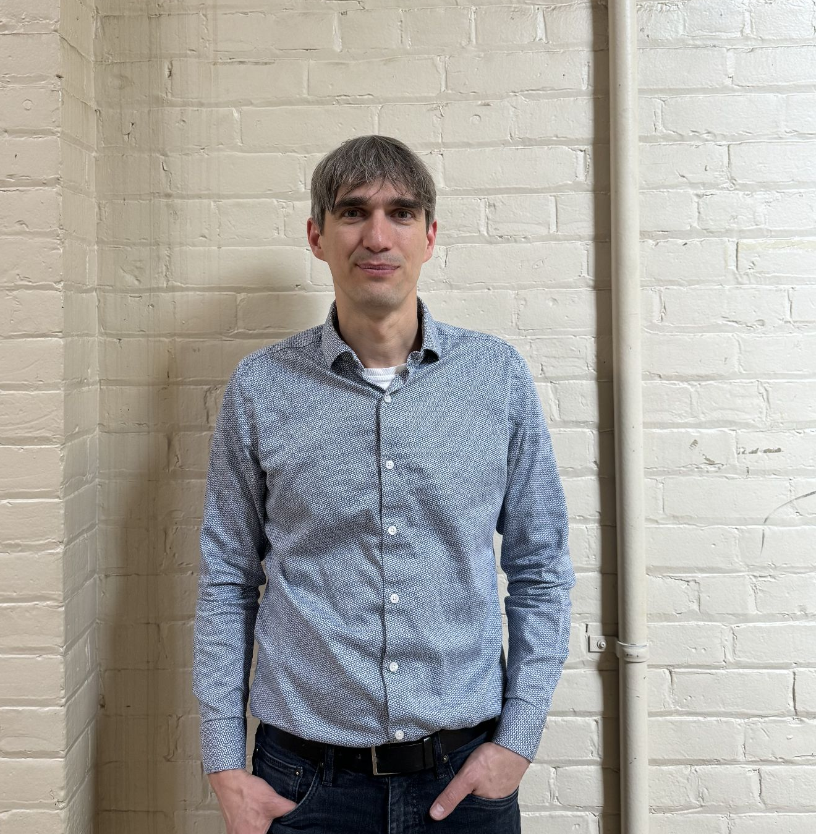
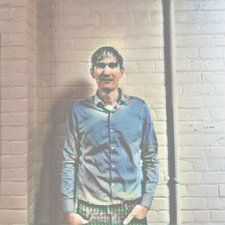
Real Photo to Cartoon
Real
Cartoon

Slide 9
Real Video to Animated Clip
Video → Frame Extraction → CartoonGAN → Reassembled Animation
Real Video
Animation-Style

Slide 10
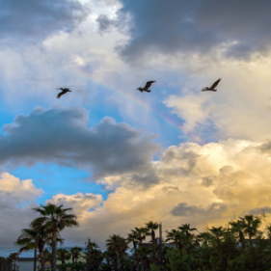
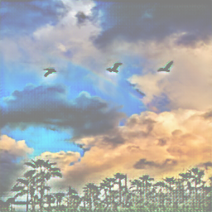
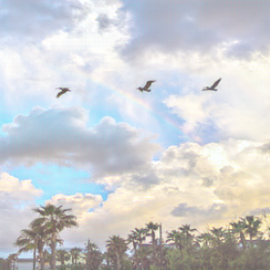
Results
Qualitative:
Preserved details - Sharp edges
Stylized Colors - Bad for dark pictures
Original
Transfer Learning
Scratch

Slide 11
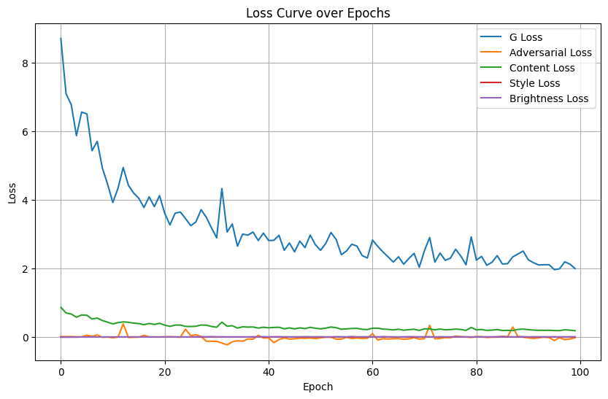
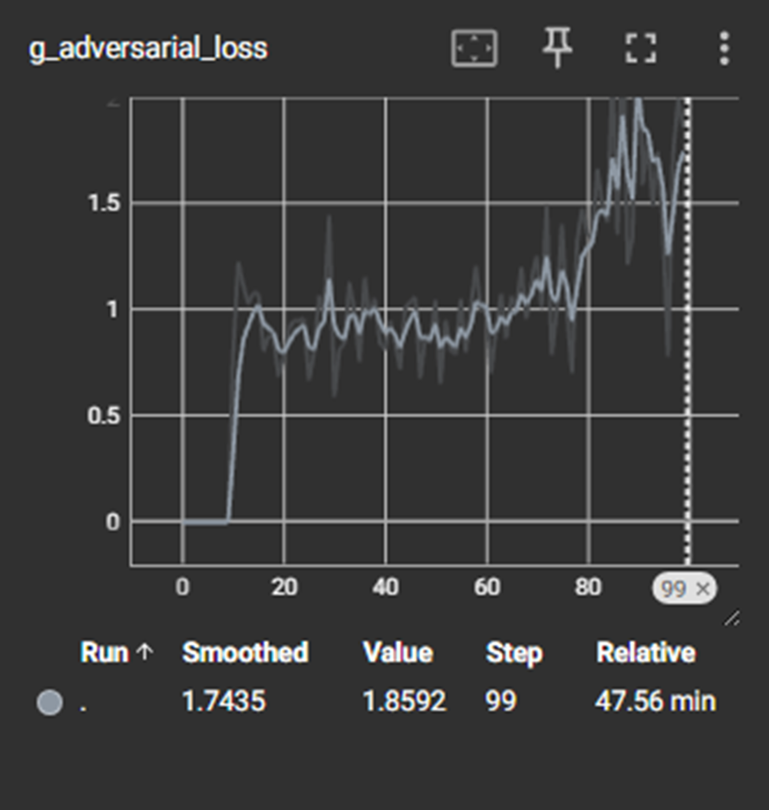
Results
https://tobiassunderdiek.github.io/cartoon-gan/#tc5_1
Quantitative:
Generator Adversarial Loss
From Scratch
Transfer Learning

Slide 12
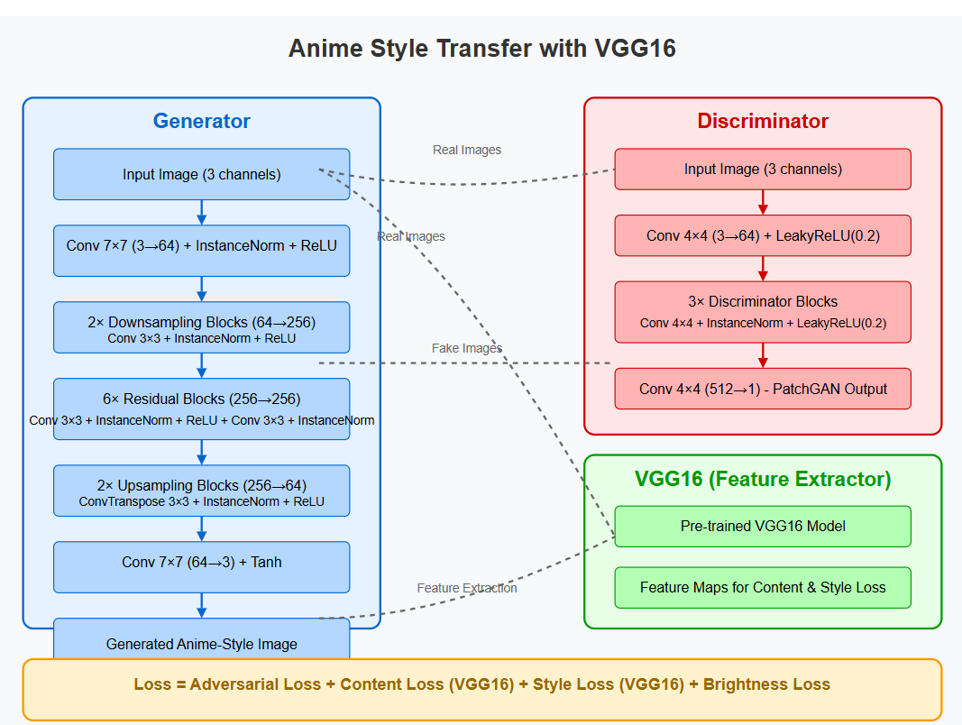
Why We Abandoned The Scratch Model
Scratch Model Architecture
Hardware Limitations: GPU constraints limited training to less than 200 epochs
Brightness Loss: Model preserved original brightness but failed to adapt to anime style lighting
VGG Feature Extraction: Only used up to layer 21 vs. 24 in transfer learning model
Content-Style Balance: Content preservation dominated over style transformation
Loss Function Design: Initial epochs focused too heavily on content preservation
Result: Images retained brightness and structure but lacked anime style characteristics

Slide 13
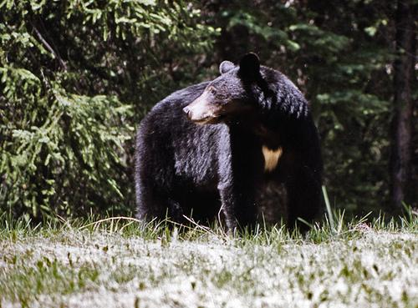
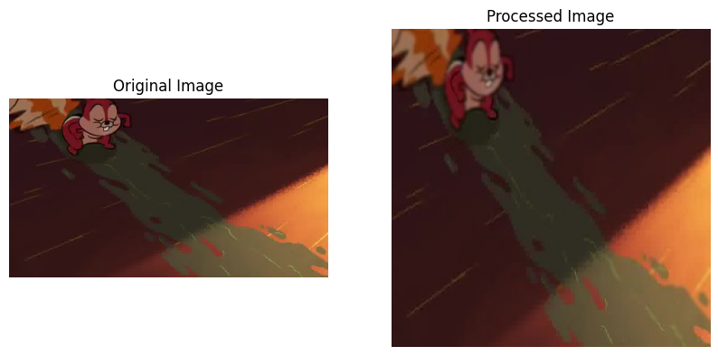
End-to-End Pipeline: Data
COCO
Data: Three Categories
One Thousand COCO Dataset(10 species of animals)
Seven Thousand Disney Cartoon Images (Webscript)
Seven Thousand Processed Disney Cartoon Images
Edge Detection and Enhancement: Using the Canny algorithm to detect edges, followed by dilation operations to enhance those edges.
Gaussian Filtering for Smoothing: Applying Gaussian filters to edge regions, creating cartoon-like smooth transitions in the image.
Disney

Slide 14
End-to-End Pipeline: Architecture
Generator: Encoder-decoder with residual blocks
Input → Conv → Downsampling → Residual Blocks → Upsampling → Output
Uses Instance Normalization and ReLU activations
Discriminator: CNN with 5 convolutional layers
Distinguishes between real and generated images
Uses LeakyReLU activations
VGG16 Feature Extractor: Pre-trained network
Extracts content and style representations
Frozen during training

Slide 15
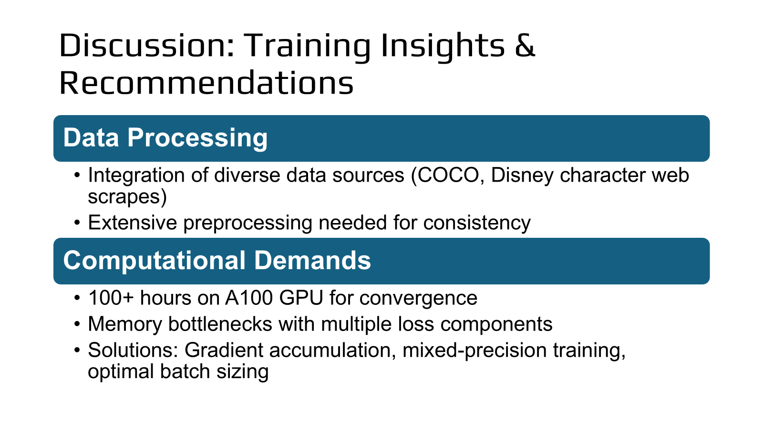
Discussion: Training Insights & Recommendations
Training Challenges
Complex balance between content preservation and style transfer
Unreliable loss metrics vs. visual quality assessment
Mode collapse prevention using spectral normalization and adaptive instance normalization
Recommendations for Future Projects
Start with smaller, controlled datasets
Implement comprehensive experiment tracking from day one
Allocate extra time for hyperparameter tuning
Focus on visual quality improvements beyond loss metrics

Slide 16
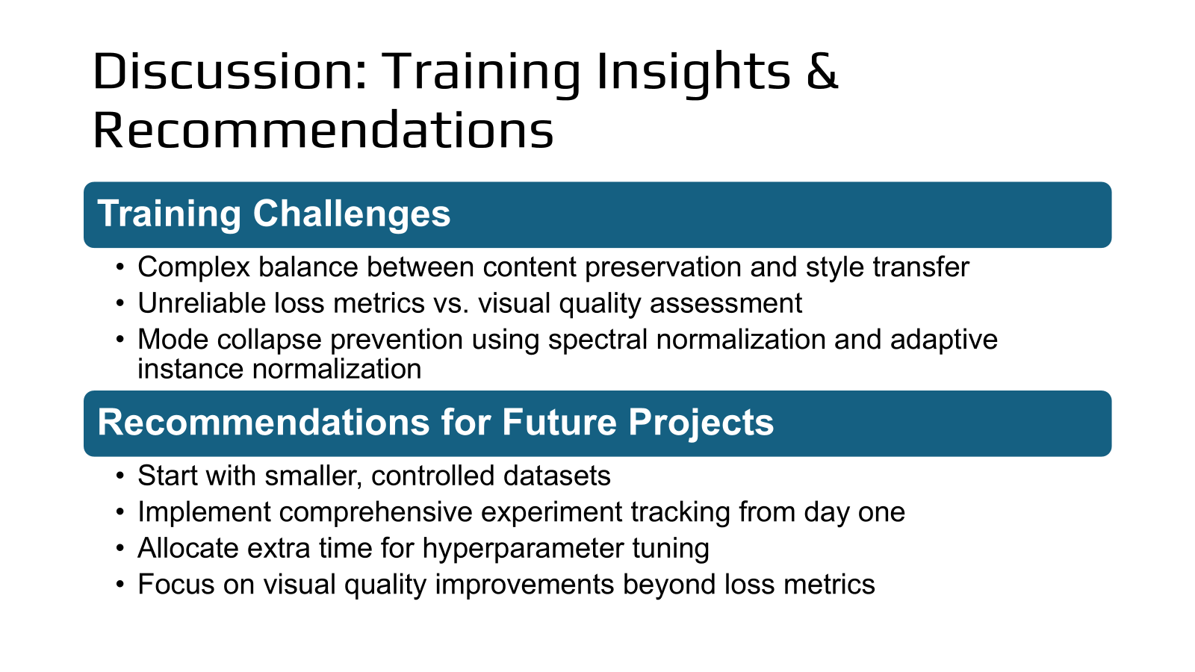
Discussion: Data & Computational Challenges
Data Processing
Integration of diverse data sources (COCO, Disney character web scrapes)
Extensive preprocessing needed for consistency
Computational Demands
100+ hours on A100 GPU for convergence
Memory bottlenecks with multiple loss components
Solutions: Gradient accumulation, mixed-precision training, optimal batch sizing

Slide 17

Questions?

